Slide 1



Constructing the Knowledge Base for Cognitive IT Service Management
Qing Wang¹, Wubai Zhou¹, Chunqiu Zeng¹, Tao Li¹,
Larisa Shwartz²
Genady Ya. Grabanrnik³
¹School of Computing and Information Science, Florida International University Miami, FL, USA ²Cognitive Service Management, IBM T.J. Watson Research Center Yorktown Heights, NY, USA ³Dept. Math & Computer Science, St. John’s University, Queens, NY, USA

Slide 2
Outline
Introduction
System Overview
Approaches to construct the knowledge base
Phrase Extraction Stage
Knowledge Construction Stage
Ticket Resolution Stage
Experiment
Conclusion and Future
1

Slide 3
Transitioning from practitioner-driven technology-assisted to technology-driven and practitioner-assisted delivery of services
Enterprises and service providers are increasingly challenged with improving the quality of service delivery
The increasing complexity of IT environments dictates the usage of intelligent automation driven by cognitive technologies, aiming at providing higher quality and more complex services.
Software monitoring systems are designed to actively collect and signal anomalous behavior and, when necessary, automatically generate incident tickets.
Solving these IT tickets is frequently a very labor-intensive process.
Full automation of these service management processes are needed to target an ultimate goal of maintaining the highest possible quality of IT services. Which is hard!
Notes:
Lifecycle of an issue/problem
To keep them healthy and secure - Keep the services running 99% of time
To keep improving them

Slide 4
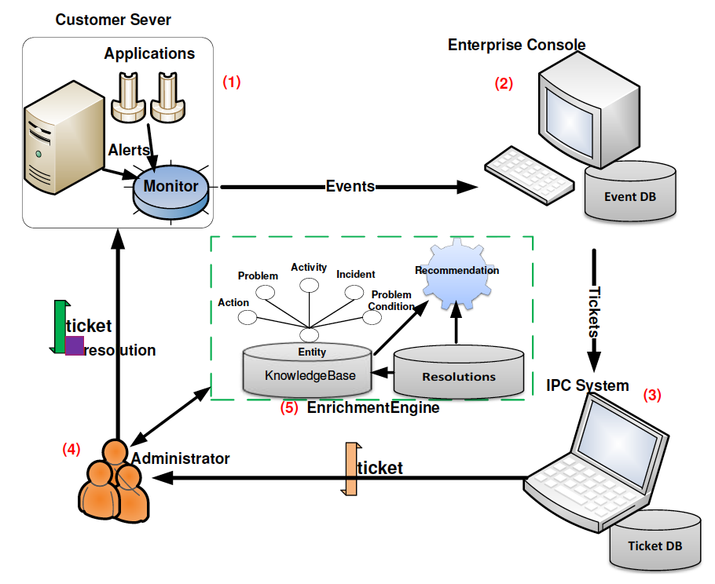
Background
Monitoring system: emits an event if anomalous behavior persists beyond a predefined duration.
Event Management system: determines whether to create an incident ticket.
IPC (Incident/Problem/Change) System: record keeping system that collects the tickets and stored them for tracking and auditing purposes.
System Administrators (SAs): performs problem determination, diagnosis, and resolution.
Enrichment Engine: uses various data mining techniques to create, maintain and apply insights generated from a knowledge base to assist in resolution of an incident ideally with an automation.
This research focuses on Enrichment engine
The overview of IT service management workflow.
2
Notes:
Software systems involved
IT service management and particularly problem determination, diagnosis, and resolution require a large investment of manual effort by system administrators.
Goal – to remove repeatable issues from System Admin plate
We have data – what is stopping us?

Slide 5
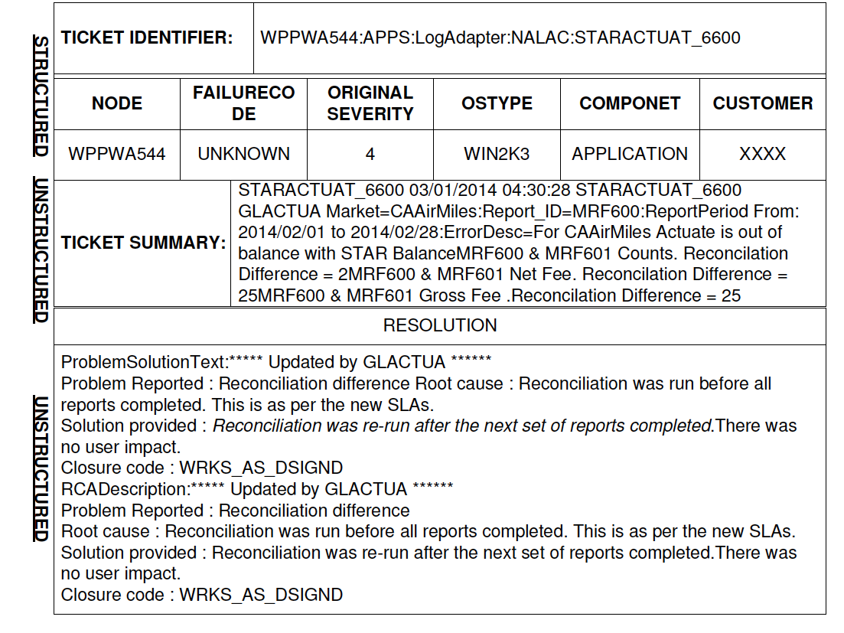
Motivation
Structured fields:
often inaccurate or incomplete
especially information which is not generated by monitoring systems
Unstructured text:
written by system administrators in natural language. Potential knowledge includes:
What happened? Problem
What troubleshooting was done? Activity
What was the resolution? Action
A ticket in IT service management and its corresponding resolution are given.
Notes:
Problems denote what problem occurred.
Activities indicate the diagnostic steps.
Actions represent the fix applied to mitigate the problem.

Slide 6
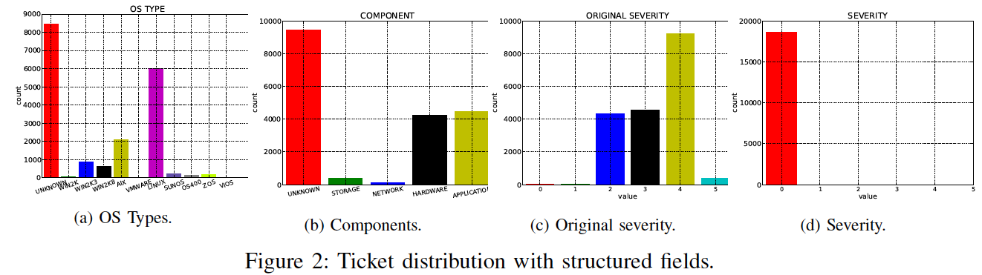
Challenge
Challenge 1: Even in cases where the structured fields of a ticket are properly set, they either have small coverage or do not distinguish tickets well, and hence they contribute little information to the problem resolution
Challenge 2: The ambiguity brought by the free-form text in both ticket summary and resolution poses difficulty in problem inference, although more descriptive information is provided
Ticket distribution with structure fields.

Slide 7
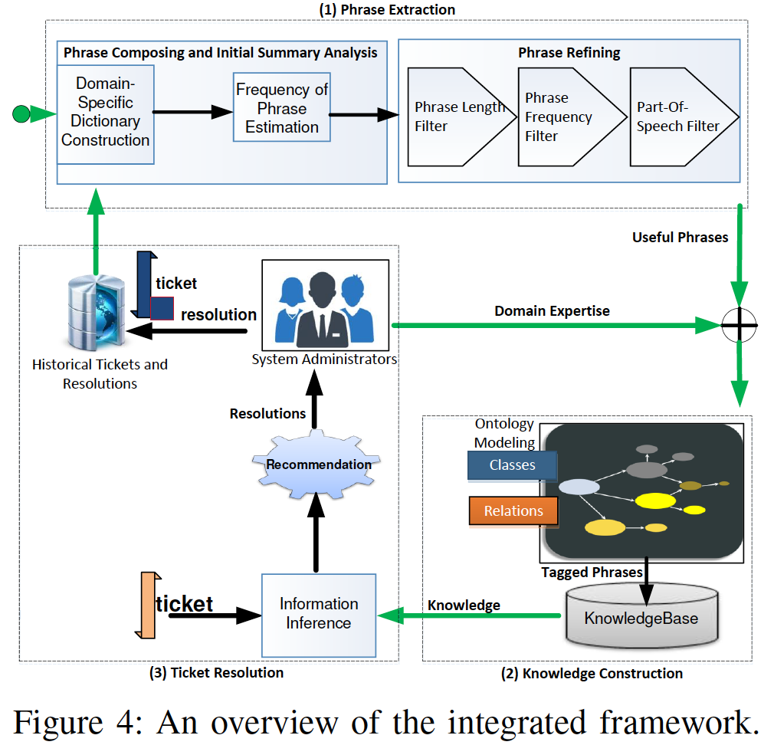
System Overview
Our proposed integrated framework consists of three stages:
（1）Phrase Extraction Stage
Phrase Composition and Initial Summary Analysis Component
(b) Phrase Refining Component
（2）Knowledge Construction Stage
（3）Ticket Resolution Stage
An overview of the integrated framework.

Slide 8
Phrase Extraction Stage
In this stage, our framework finds important domain-specific words and phrases (‘kernel’).
Constructing domain-specific dictionary
Mining the repeated words and phrases from unstructured text field.
Refining these repeated phrases by diverse criteria filters (e.g., length, frequency, etc.).

Slide 9

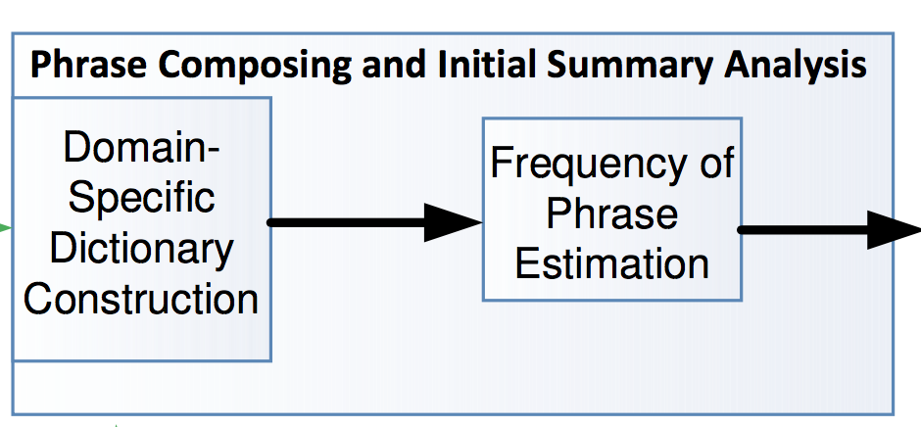
Phrase Composition and Initial Summary Analysis
Hot Phrases
Patten + Frequence
History tickets data
Repeated pattern extraction and frequency estimation.
Use StanfordNLPAnnotator for preprocessing ticket data.
Build a domain dictionary by using Word-Level LZW compression algorithm.
Calculate the frequency of the repeated phrases in tickets data by using Aho-Corasick algorithm.
Notes:
History Tickets and resolutions as input are provided for Phrase Composing and Initial Summary Analysis Component
Repeated Pattern Extraction : tokenize text into sentences and use word-level LZW compressor to get the repeated pattern. We have a dictionary now.
Both of the text and generated dictionary are used as input for Aho-Corasick algorithm.
Aho-Corasick algorithm is used to frequency estimation for the repeated pattern in the tickets data and it is single pass.
[1] Welch, T. Technique for high-performance data compression. Computer 17, 6(1984), 8-19.
[2] Commentz-Walter, Beate. "A string matching algorithm fast on the average. "International Colloquium on Automata, Languages, and Programming. Springer Berlin Heidelberg, 1979.

Slide 10
Phrase Composition and Initial Summary Analysis
Word-Level Lempel-Ziv-Welch (WLZW)
Seeks the trade-off between completeness and efficiency and attempts to find the longest n-gram with a repeated prefix
Time complexity: O(n)
Aho-Corasick algorithm
Locate all occurrences of any of a finite number of keywords in a string of text.
Consists of constructing a finite state pattern matching machine from the keywords and then using the pattern matching machine processing the text string in a single pass.
Time complexity: O(n).

Slide 11
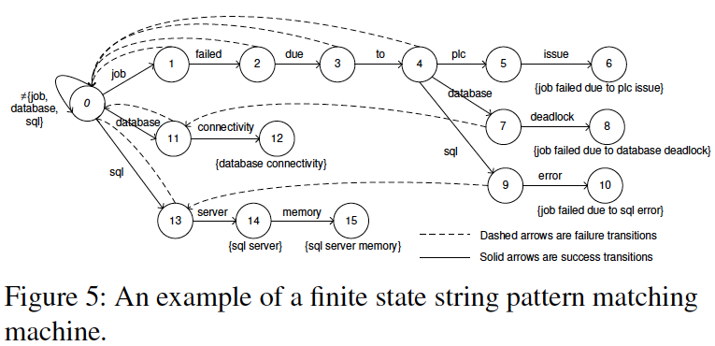
Phrase Composition and Initial Summary Analysis
Assume we have a dictionary D composing { “job failed due to plc issue,” “job failed due to database deadlock,” “job failed due to sql error,” “database connectivity,” “sql server,” “sql server memory” }.
An example of a finite state string pattern matching machine.
AC algorithm first constructs finite State Automaton for dictionary using a Trie.
And then estimates the frequency of the phrases in the dictionary for a single pass.
Notes:
[1] AC Algorithm Animation: http://blog.ivank.net/aho-corasick-algorithm-in-as3.html

Slide 12

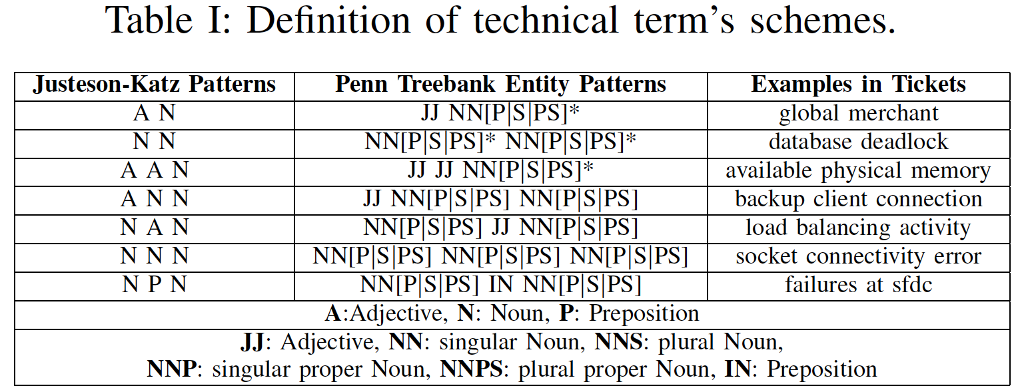
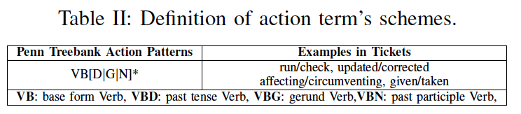
Phrases Refining
In this stage, we apply two filters to the extracted repeated phrases allowing the omission of non-informative phrases.
Phrase Length & Frequency Filters (length > 20 & frequency >= 10)
Part-Of-Speech Filter
Table III: Result of Frequency/Length Filter and PoSTag Filter.
Applied Filter | Left Phrases
Frequency Filter >= 10 | 1117 items
Length Filter > 20 | 613 items
PoSTag Filter | 323 items

Slide 13
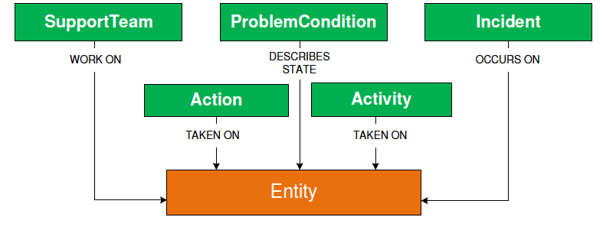
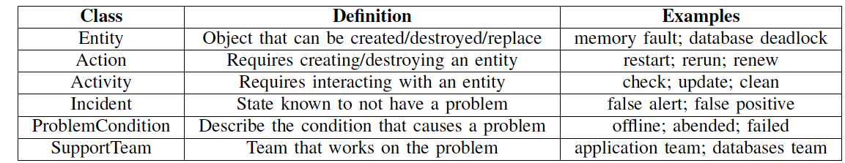
Knowledge Construction Stage
In this stage, we first develop an ontology model, and then tag all the phrases of the generated dictionary with the defined classes.
Build the ontology model
Define classes
Define relations
Knowledge Archive
Manually tag the important
phrases in the dictionary with
their most relevant defined classes.
Figure 9: Ontology model depicting interactions among classes.

Slide 14
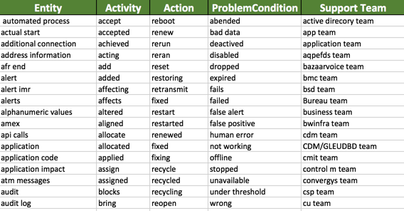
Knowledge Construction Stage
Initial Domain Knowledge Base:
Class | Number of Tagged Phrases
Entity | 628 items
Activity | 243 items
Action | 24 items
Problem Condition | 22 items
SupportTeam | 76 items

Slide 15
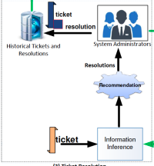

Ticket Resolution Stage
The goal of this stage is to recommend operational phrases for an incoming ticket.
Information Inference component:
Class Tagger Module processes incoming ticket tickets in three steps.
(1) tokenize the input into sentences;
(2) construct a Trie by using ontology domain dictionary;
(3) find the longest matching phrases of each sentence using the Trie and knowledge base, then map them onto the corresponding ontology classes
Define Concept Patterns for Inference: concept patterns based on Problem, Activity and Action concepts:
1. Problem describes an entity in negative condition or state.
2. Activity denotes the diagnostic steps on an entity.
3. Action represents the fixing operation on an entity.
Notes:
The module has three steps for tagging: (1) tokenize the input into sentences; (2) construct a Trie by using ontology domain dictionary; (3) find the longest matching phrases of each sentence using the Trie and knowledge base, then map them onto the corresponding ontology classes.: “database,” “deadlock,” and “database deadlock” are all valid domain phrases of Entity class. But the Class Tagger module only tags the “database deadlock” as Entity in a given sentence.

Slide 16
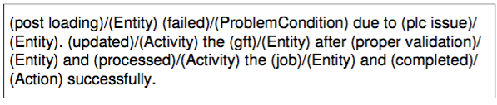
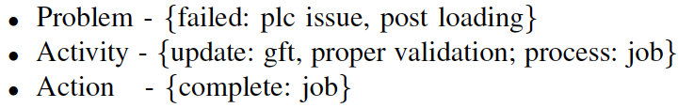
Ticket Resolution Stage
Problem, Activity and Action Extraction:
1. Class Tagger module tokenizes the input into sentences and outputs a list of tagged phrases.
2. We decide whether it is an informative snippet or not by checking if it exists in a Problem-Condition/Action list.
3. The phrase is appended to the dictionary as a key, and all its related entities are added as the corresponding values via a neighborhood search. Each of the three key concepts has its own dictionary.
Finally, we obtain the problem, activity, and action inferences.

Slide 17
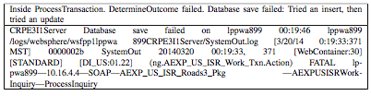
Ticket Resolution Stage
The goal of this stage is to recommend operational phrases for an incoming ticket.
Ontology-based Resolution Recommendation component
Previous study, the KNN-based algorithm will be used to recommend the historical tickets’ resolution to the incoming ticket which have the top summary similarity scores.
Jaccard similarity performs poorly due to noisy text (many non-informative words): two tickets describes the same issue
Ontology model can greatly facilitates our resolution recommendation task by better capturing the similarity between ticket summaries.
Notes:
Ontology construction in ticket summary follows the same steps as in ticket resolution. But ticket summary delivers the problem symptoms instead of the problem resolution information. It is reasonable to assume that only problem and activity phrases present in ticket summary.

Slide 18
Experiment
Dataset
Experimental tickets are collected from real production servers of IBM Cloud Monitoring system covers three month time period containing |D| = 22,423 tickets.
Training data: 90% of total tickets
Testing data: 10% of total tickets
Evaluation Metrics
Precision, Recall, F1 score and Accuracy.
Accuracy = (TP + TN)/(TP + TN + FP + FN)
Precision = TP/(TP + FP) Recall = TP/(TP + FN)
F1 score = 2 Precision Recall / (Precision + Recall)
Notes:
Four commonly used evaluation metrics are applied in
our evaluation. Let TP, TN, FP, and FN correspond to true
positive, true negative, false positive, and false negative,
respectively.

Slide 19
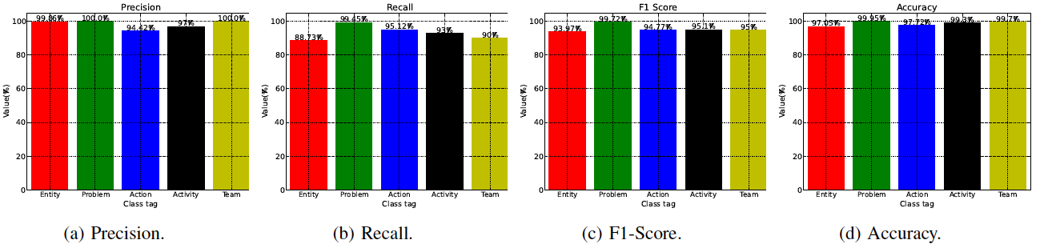
Experiment
Ground Truth
Domain experts manually find and tag all phrases instances into six predefined classes in testing dataset.
Evaluate our integrated system
Class Tagger is applied to testing tickets to produce tagged phrases with predefined classes. Comparing the tagged phrases with ground truth, we obtain the performance.
Evaluation of our integrated system.

Slide 20
Experiment
Evaluate Information Inference
Usability: we evaluate the average accuracy to be 95.5%, 92.3%, and 86.2% for Problem, Activity, and Action respectively.
Readability: we measure the time cost. Domain expert can be quicker to identity the Problem, Activity and Action which output from the Information Inference component from 50 randomly selected tickets.

Slide 21
Conclusion and Future Work
Contribution
A novel domain-specific approach.
Utilization of the ontology modeling techniques.
Automation improvement of IT service management.
A closed feedback loop system for continuously extending of the knowledge base.
Future Work
Investigate intelligent techniques to reduce human efforts on phrase tagging, such as training a conditional random field model.
Leverage the ontology into Deep Learning model.
Incorporate the obtained knowledge base into other tasks in the IT service management system.
Notes:
A novel domain-specific approach, designed to analyze free-form text in both ticket summary and resolution for useful phrase extraction.
Utilization of the ontology modeling techniques, constructing a knowledge base by combining domain expertise with extracted useful phrases.
Automation improvement of IT service management, through development of a resolution recommendation component based on domain knowledge.
A closed feedback loops system, to facilitate learninign from an outcome of resolution recommendation, and thus continuous extension of the knowledge base.

Slide 22

Q & A

